Slide 1
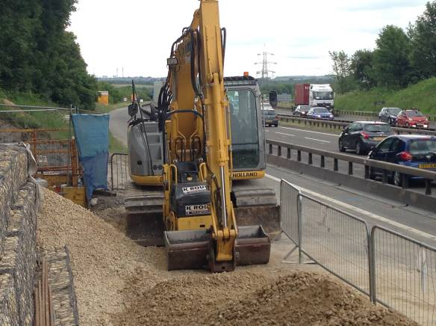
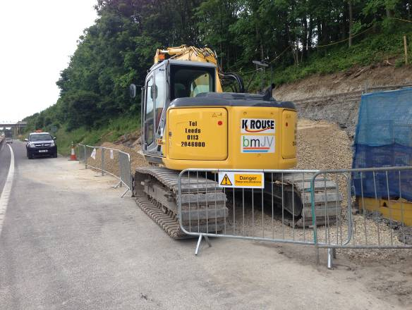
“Tool Box Talk – Safe parking of mobile plant equipment”
Lost time injury (Jun-14)
A KRCE Plant operator twisted his Left Knee after stockpiled stone on which he was stood gave way and caused him to fall backwards
After exiting the Tracked Excavator he had been operating at the end of his nightshift, the operator had struggled to remove the isolator key, hidden behind a side panel, from his standing position on the track of the machine
Instead, he stepped down onto a stockpile of stone material located next to the Excavator. Then, after successfully removing the isolator key, the loose stone on which he was stood gave way, resulting in injury
Key learning;
Mobile plant to be parked on firm level ground, ensuring safe access for pedestrians around the perimeter, i.e. free from slip and trip hazards, including stockpiled stone
During hours of darkness, plant operators to use hand held torches, as well as helmet torches issued as standard. This in addition to artificial task lighting that must be provided for each work location
All personnel reminded of the need to check conditions underfoot – i.e. uneven ground, potholes, slippery conditions, obstructions, traffic, uphill/downhill, light/dark, etc
The green arrow shows both the pile of stone the IP was stood on and the direction he fell in.
The red arrow shows the panel that the operator had opened to remove the isolator key

